Slide 1


Introduction to Competitive Programming
Week 7: Recursion, Dynamic Programming
Notes:
https://join.slack.com/t/introductiont-c5a2137/shared_invite/zt-djtdwpqu-S_tju9SZhk2IKhcYICitCQ

Slide 2
1.
Introduction

Slide 3
What is recursion?
Recursion is a method of solving a problem where the solution depends on solutions to smaller instances of the same problem.
Classic: Factorial
N! = N * (N - 1) * (N - 2) * … * 2 * 1
3! = 3 * 2 * 1 = 6
5! = 5 * 4 * 3 * 2 * 1 = 120

Slide 4

N! = N * (N - 1) * (N - 2) * … 3 * 2 * 1

Slide 5
N! = N * (N - 1) * (N - 2) * … 3 * 2 * 1
(N - 1)!

Slide 6
N! = N * (N - 1) * (N - 2) * … 3 * 2 * 1
N! = N * (N - 1)!
(N - 1)!

Slide 7
N! = N * (N - 1) * (N - 2) * … 3 * 2 * 1
N! = N * (N - 1)!
6! = 6 * 5! = 6 * (5 * 4 * 3 * 2 * 1)
(N - 1)!

Slide 8
N! = N * (N - 1) * (N - 2) * … 3 * 2 * 1
N! = N * (N - 1)!
6! = 6 * 5! = 6 * (5 * 4 * 3 * 2 * 1)
Recursion is a method of solving a problem where the solution depends on solutions to smaller instances of the same problem.
(N - 1)!

Slide 9
Recursive Functions
What is a function (in computer science)?
A function is a block of organized, reusable code that is used to perform a single, related action.
Let’s write a function that computes the factorial of a number!
First, an iterative function
Repeatedly does some action

Slide 10
Recursive Functions
What is a function (in computer science)?
A function is a block of organized, reusable code that is used to perform a single, related action.
Let’s write a function that computes the factorial of a number!
First, an iterative function
Repeatedly does some action
Second, a recursive function
Uses solutions to smaller instances of the same problem

Slide 11
2.
Dynamic Programming

Slide 12
Motivation
When recursion is too slow…
Turn to Dynamic Programming (DP)!
Plan
Read a problem
Solve with recursion
Realize it is slow
Fix with DP

Slide 13
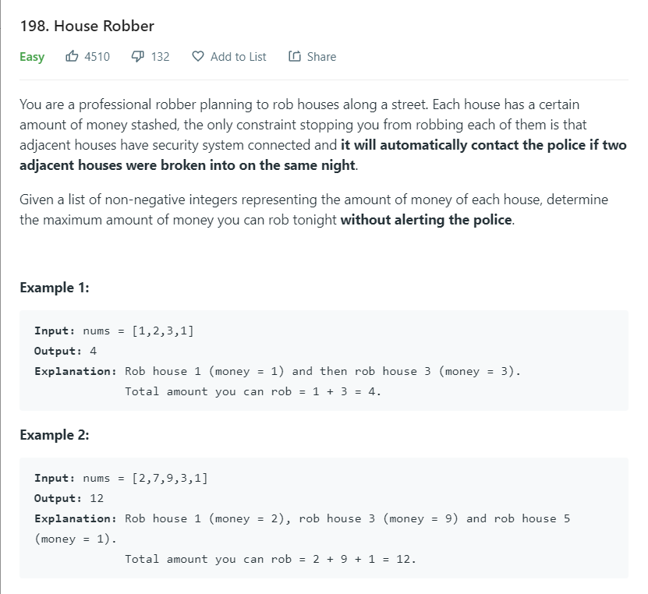

Slide 14
Dynamic Programming
Typical recursion (“Top down”)
Compute profit(6)
Realize we need profit(5) and profit(4)
Compute profit(5) and profit(4)
etc.
Dynamic Programming (“Bottom Up”)
Compute profit(1), profit(2)
Compute profit(3) using profit(1) and profit(2)
Compute profit(4) using profit(2) and profit(3)
etc.

Slide 15
3.
Trees

Slide 16
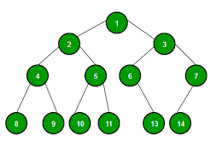
Definition
A tree is a special kind of graph
Formally:
A graph that is
Connected
Has no cycles

Slide 17
Definition
A tree is a special kind of graph
Formally:
A graph that is
Connected
Has no cycles
Subtree:
A subtree of a tree T consists of
a node in T as well as all of its
descendants (children etc.)

Slide 18
(Depth First Search) DFS Traversal
How do we visit all the nodes in a tree?
Define a function dfs(n) that visits all of the nodes in the subtree of node n
def dfs(n):
check off node n as visited
dfs(k) for all of node n’s children

Slide 19
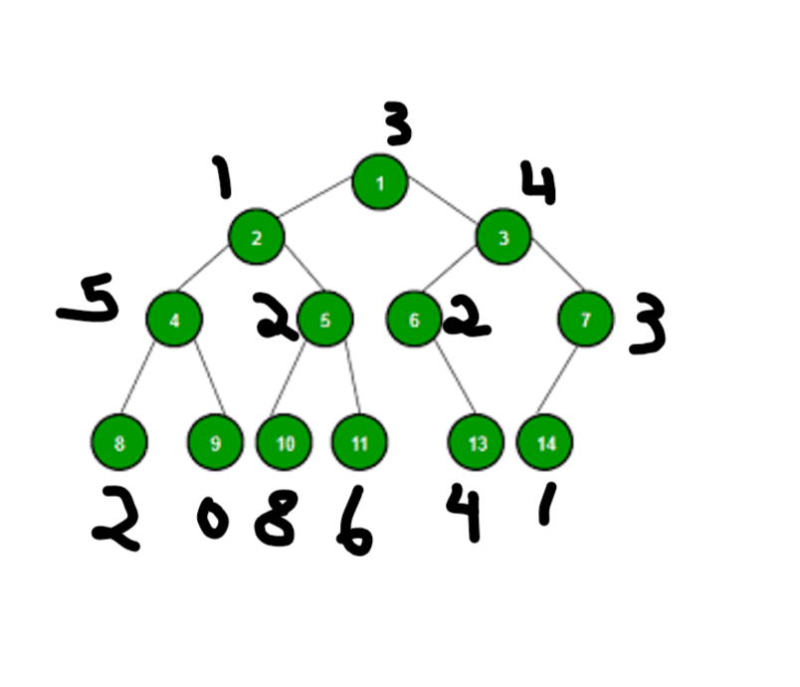
Application: Finding sums
How do we find the sum of the values in a tree?
Define a function sum(n)
Outputs sum of numbers in subtree of
node n
def sum(n):
ans = value[n]
for child of node n:
ans = ans + sum(child)
return ans

Slide 20
4.
Endnotes

Slide 21
Homework
Week 7: Recursion, DP
Collected (email me!)
Bug fixing, optimization, concerns
Highly encouraged
4-5 / week
Leetcode

Slide 22
5.
HW Help, Q & A

